Slide 1
Структура ОГЭ-2022
Письменная часть
Аудирование 1 - выбрать верный ответ
Аудирование 2 – соотнести спикера и утверждение
Аудирование 3 – заполнить инфо по интервью
Чтение – соотнести заголовки
Чтение – True/false/ not Stated
Грамматика
Лексика (словообразование)
Письмо
Устная часть
Чтение текста
Ответы на вопросы
Монологическое высказывание по теме

Slide 2
Аудирование (3)

Slide 3
Аудирование (3)

Slide 4
Грамматика
It was about 6pm when I heard a knock on the door. It __________________ Jason, my teenage neighbour. He looked cold and upset. | BE
“What’s wrong, Jason?” “I __________________ my key and I can’t get into my house.” | LOSE
“Come in. Today’s not a day for long walks, or long waits,” I looked out the window. It __________________ hard and it was windy. | SNOW
The weather was getting __________________ every hour. | BAD
Jason __________________ off his coat and boots. | TAKE
His __________________ were wet and I gave him a pair of socks to change into. A cup of hot tea and some biscuits soon made the boy feel warm. | FOOT
“Where are your parents, Jason?” “I __________________. | NOT KNOW
I can’t call them because of this,” he pulled his phone out of his pocket and showed it to me – the screen __________________ and the phone was obviously dead. | BREAK
Jason focused on the food again. He took his __________________ biscuit and said: “I wish my mum could make biscuits like this.” | FOUR

Slide 5
Словообразование
Axel is a 9-year-old Bulgarian orphan. He was adopted by a __________________ western family. | WEALTH
His new father works as a __________________ in Sweden and he is quite rich. | BANK
Axel __________________ wrote e-mails to the director of the orphanage, Jane Smitova. He told her that he was saving his Christmas and birthday money to help his friends. Axel said that he wanted the money to be spent on presents for his former playmates. | REGULAR
Later Jane said “I understood that __________________ meant a lot to a small boy but I would never have imagined | FRIEND
that Axel could be talking about such an __________________ sum of money. | POSSIBLE
It’s so touching and we are going to spend it in a very __________________ way." The boy saved £6,000. | CARE

Slide 6
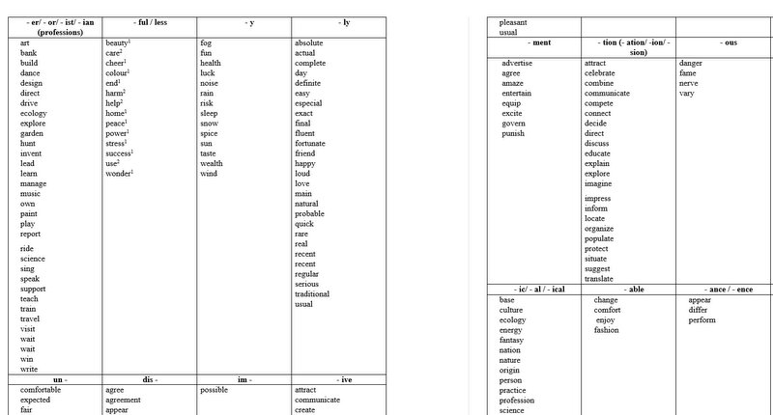
Словообразование

Slide 7
Ответы на вопросы (6)
https://speaking2022.svetlanaenglishonline.ru/

Slide 8
Электронное письмо
From: Lily@mail.uk
To: Russian_friend@oge.ru
Subject: Holidays
… You’ve probably seen the photos which I took on my holiday. During the rainy days we are having now they bring back good memories! ...Where did you spend your last summer holidays? What did you do during your holidays? What school holidays do you like most of all and why?...
Write a message to Lily and answer her 3 questions.
Write 100–120 words.
Remember the rules of letter writing.

